Slide 1
Yellow Pan Trap Experiment

Slide 2
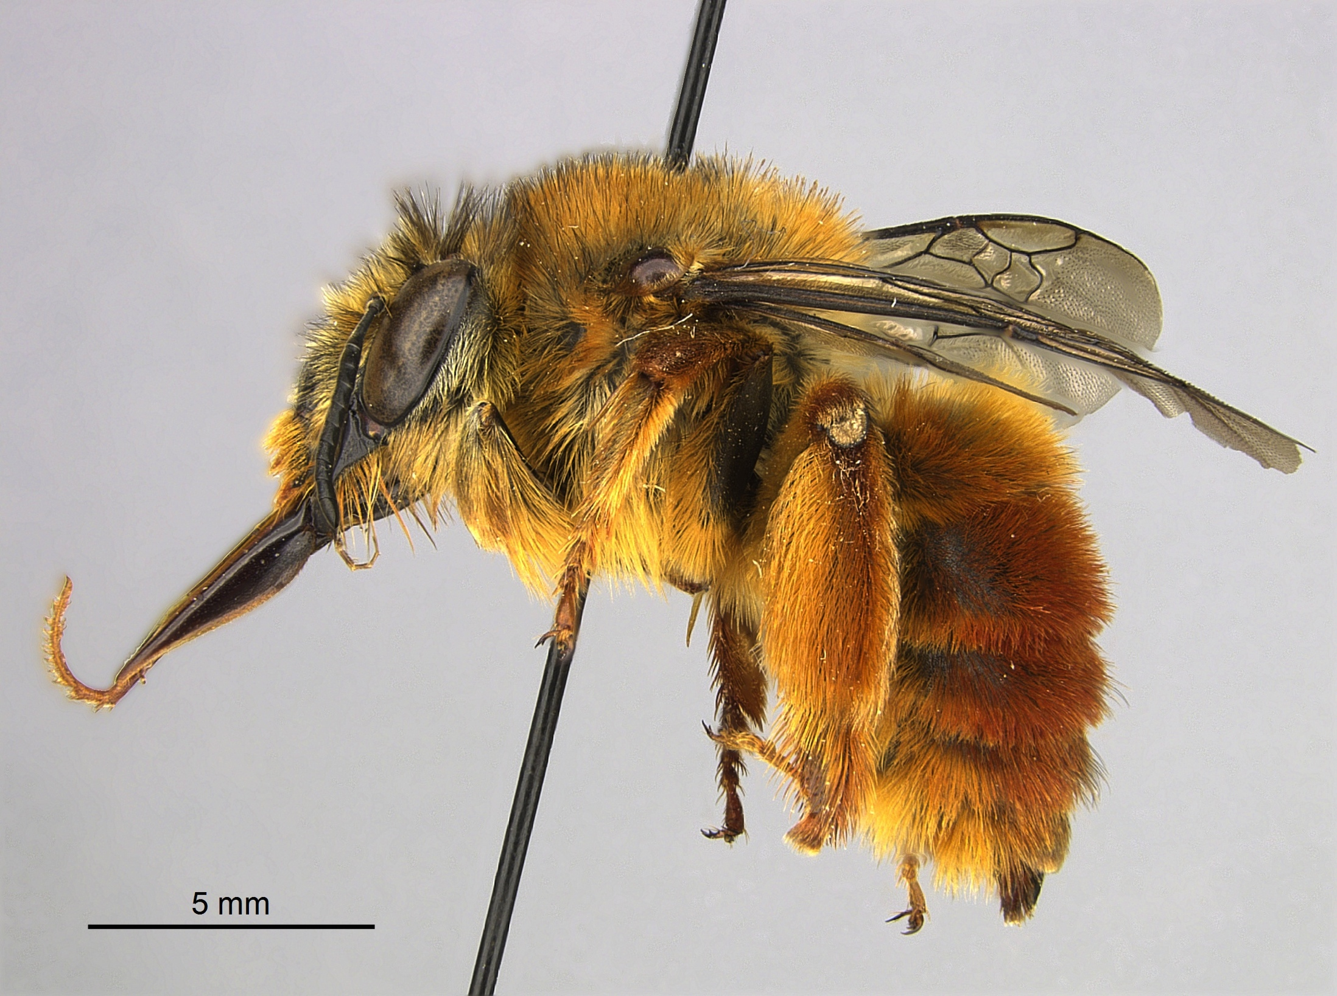
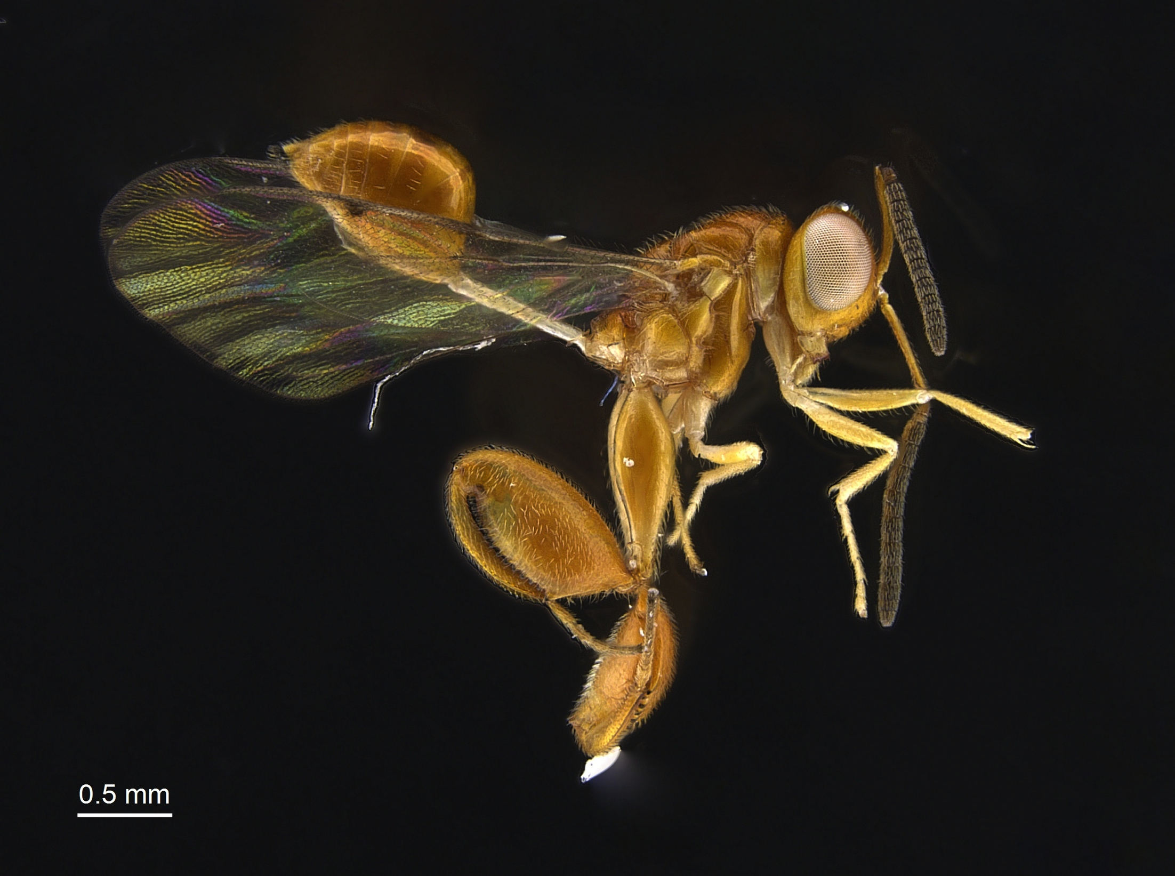
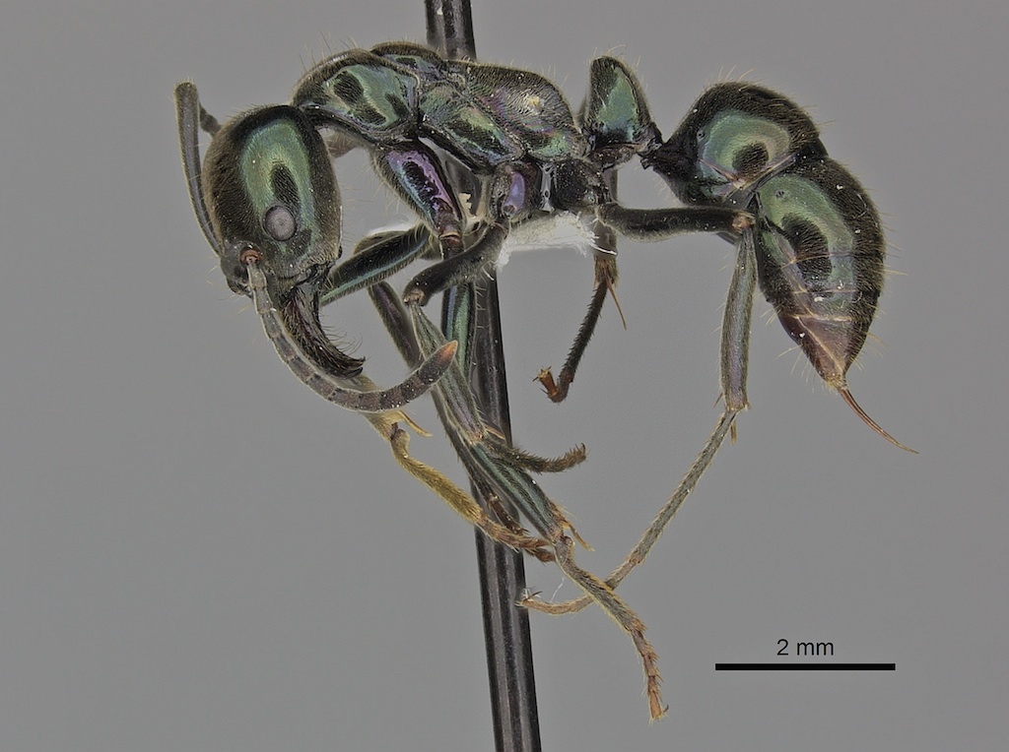
Biodiversity
The purpose for this experiment is to highlight the diversity of Hymenoptera in various micro-environments.
All three groups of Hymenoptera, Predators, Pollinators, and Parasitoids, should be recovered
This will also highlight the numbers and importance of parasitoid wasps in your school and area, a group that is relatively unknown and underappreciated.

Slide 3
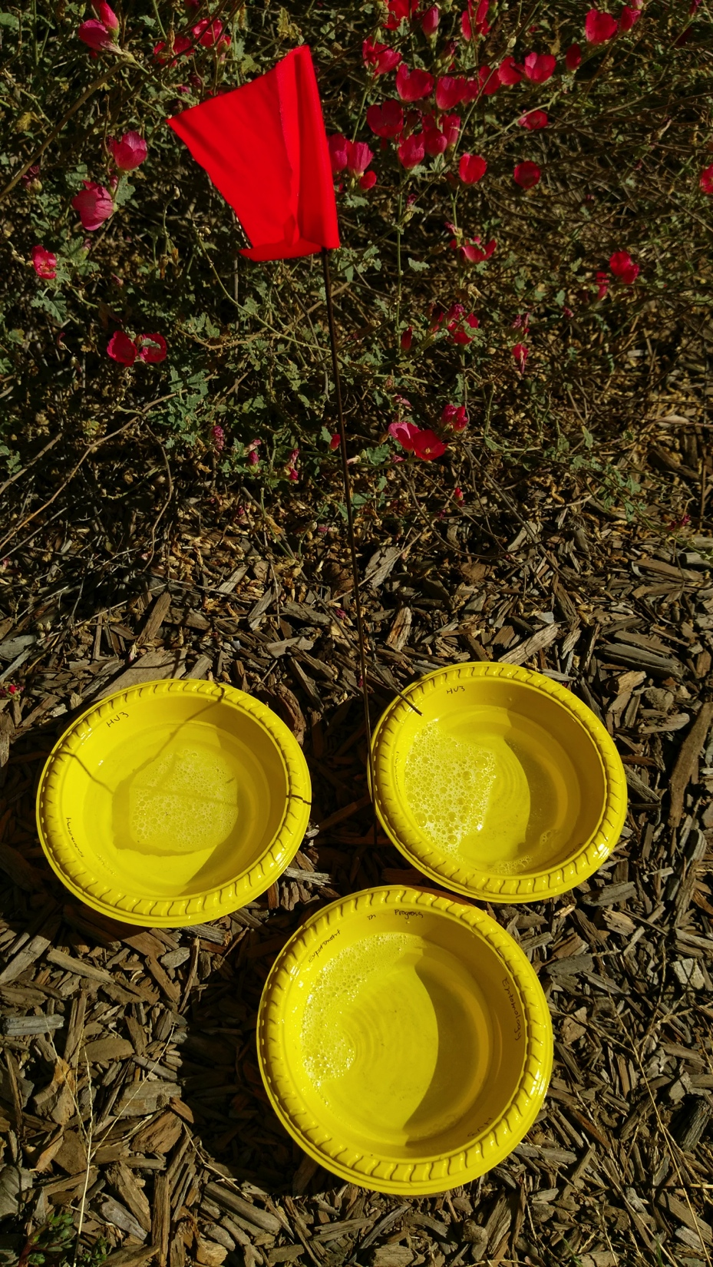
Why use Yellow Pan Traps?
Yellow pan traps attract insects
Many insects see the yellow pan as a big flower.
Some insects are simply attracted to the water.
The solution in the pan traps is a mixture of unscented dish soap and water.
Insects can normally float on the water surface
The soap breaks the water tension
Flying insects will land on the water, sink and drown.

Slide 4
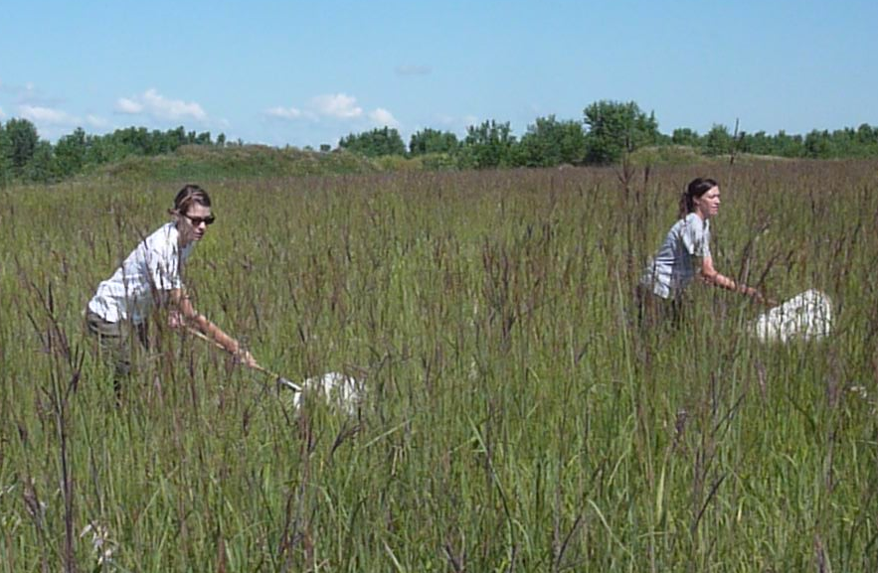
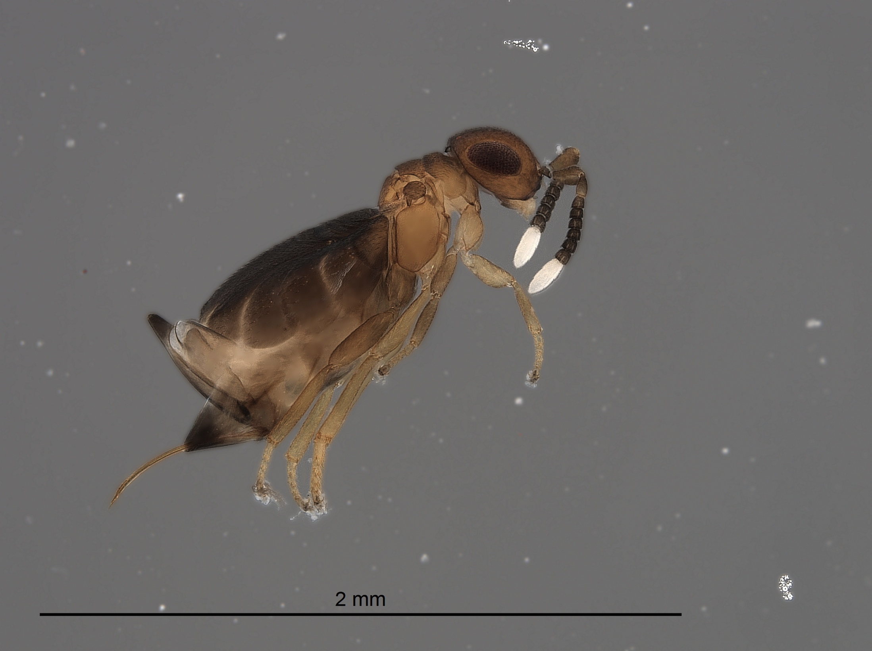
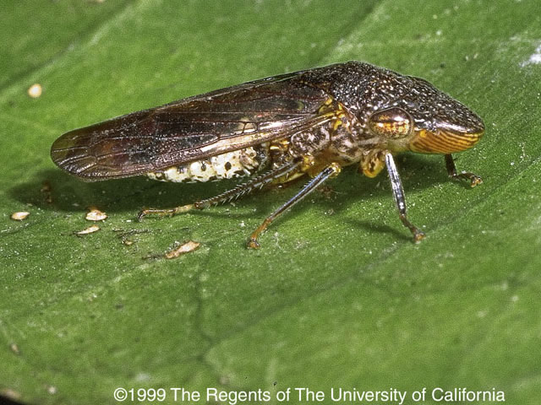
Why are yellow pan traps useful?
1. They save time and energy to collect insects
- No need to collect by sweeping or beating methods
2. Reveal insect hot spots
- Areas with high species and population numbers
3. Discovery and exploration
- New species are sometimes found
- Species distribution maps can be created
4. Early pest detection
- Help detect pests and invasive insects

Slide 5
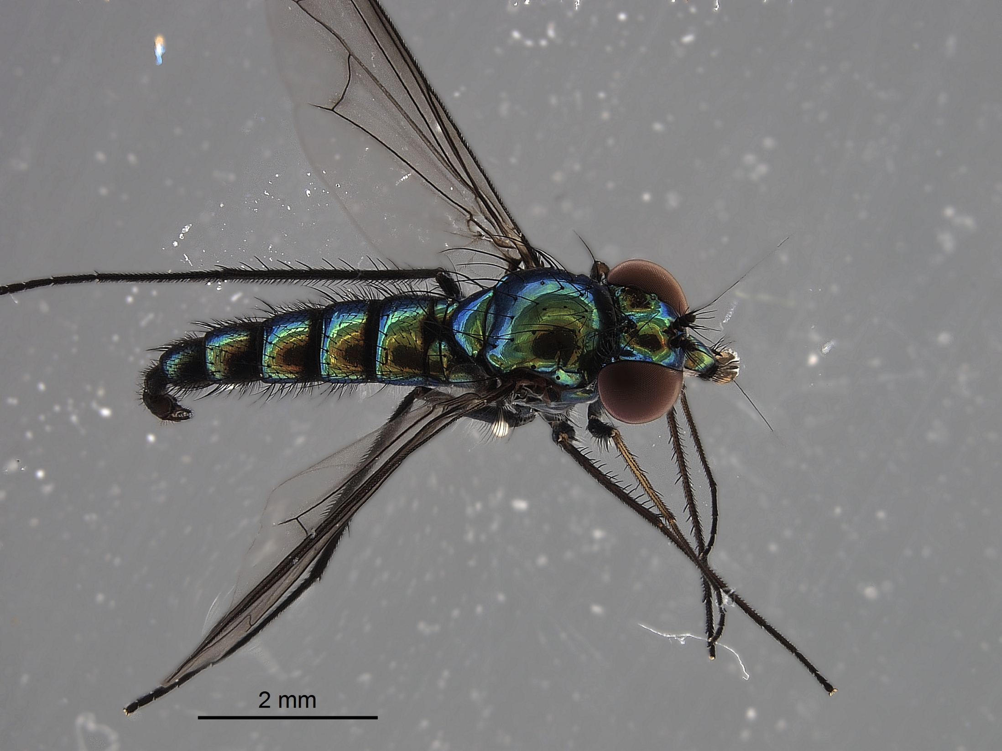
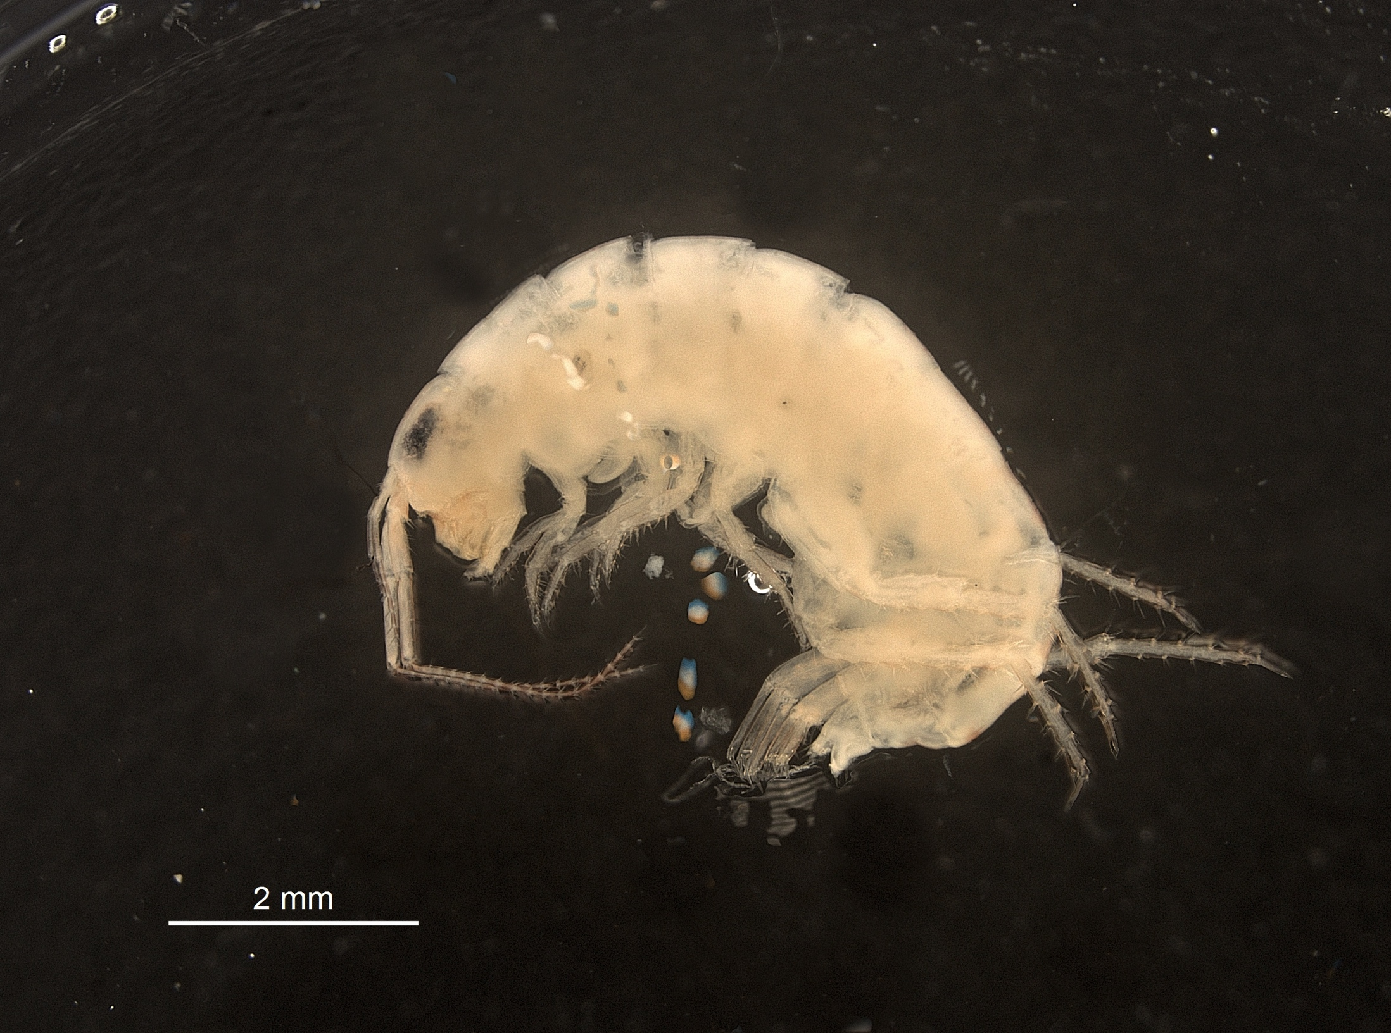
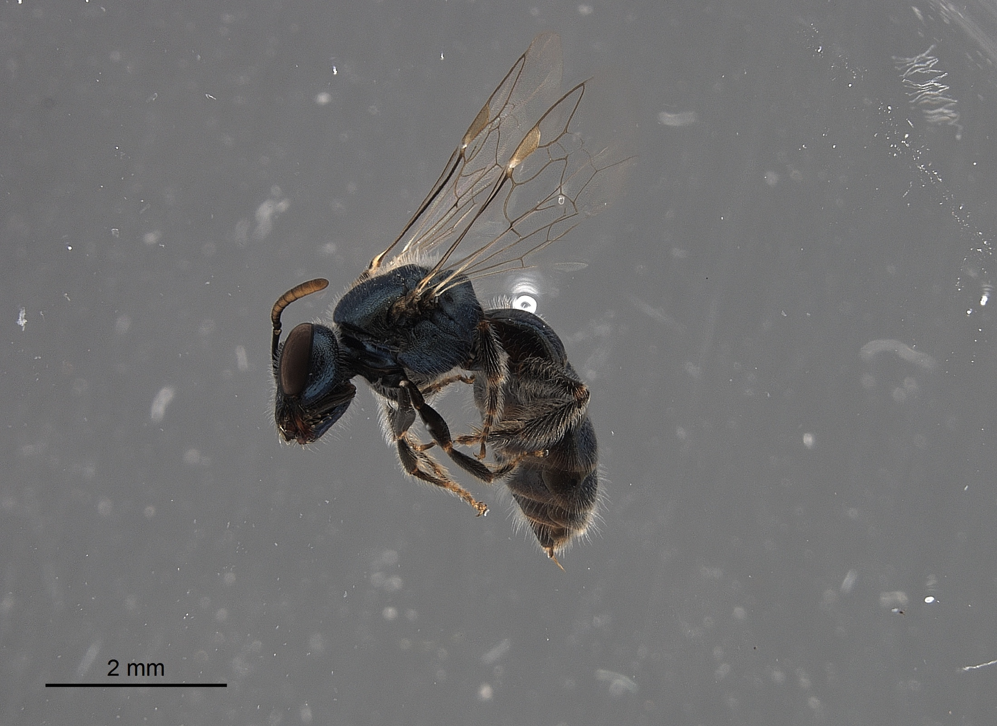
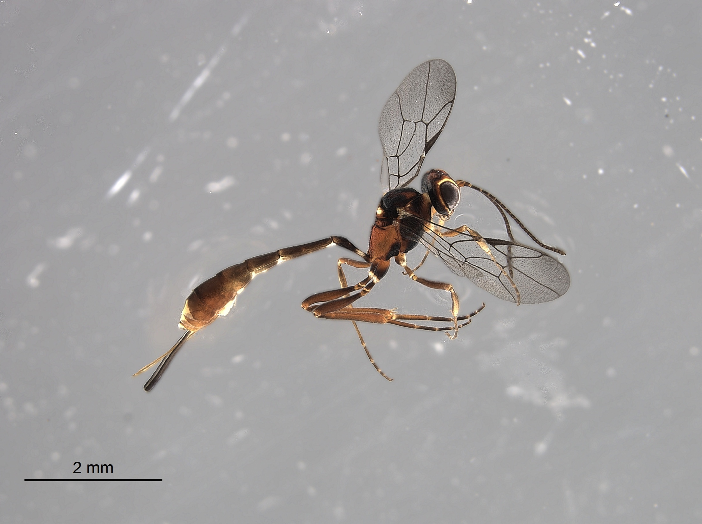
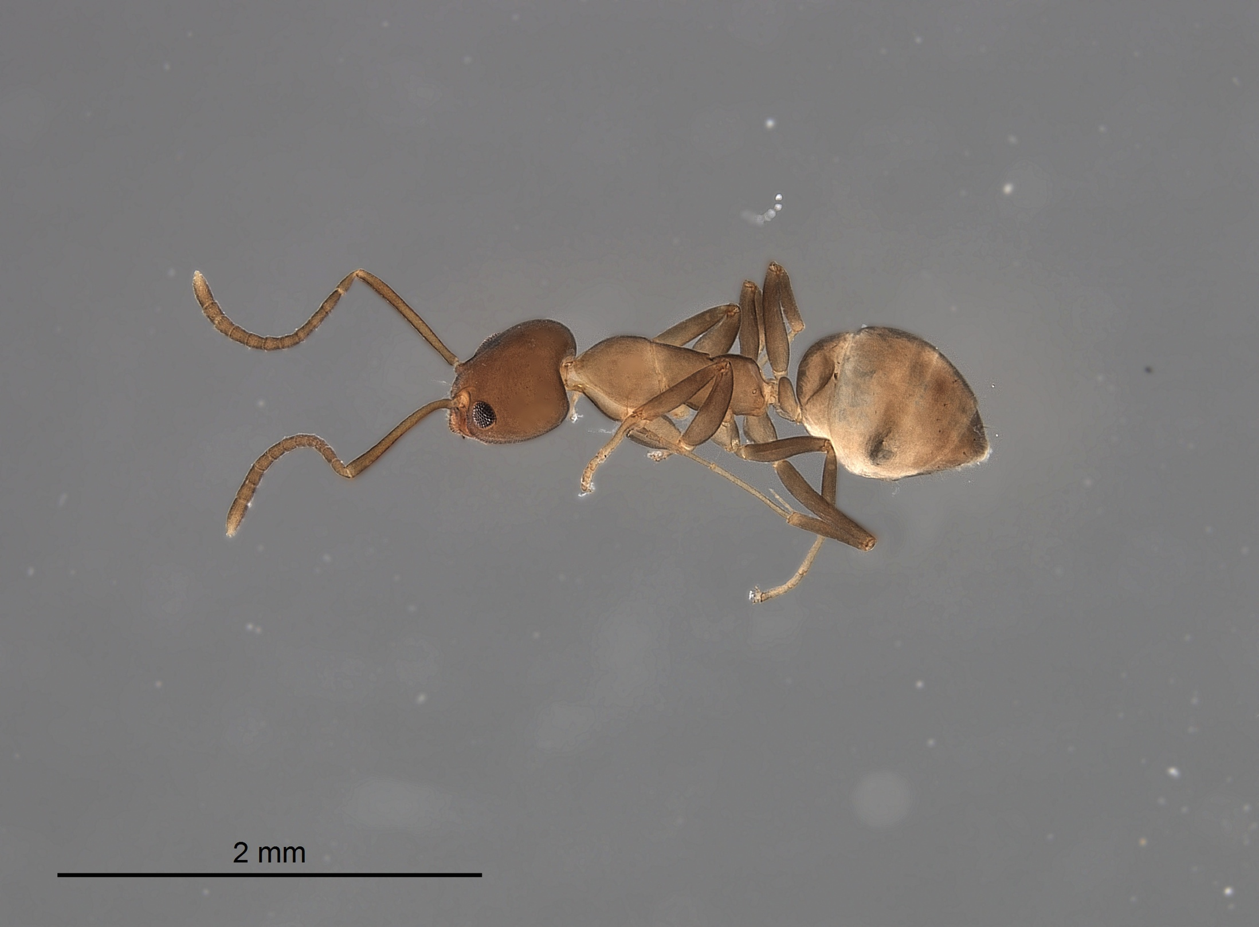
What to expect in your traps
Will hopefully have a diverse assemblage of insects and other arthropods in the traps
Spiders, “lawn shrimp”
Many other insect groups besides Hymenoptera will be found
Flies, beetles, true bugs, plant hoppers, etc.
Within Hymenoptera, there should hopefully be representatives of all three groups.
We are calling ants predators in this experiment

Slide 6
Experimental Procedures

Slide 7
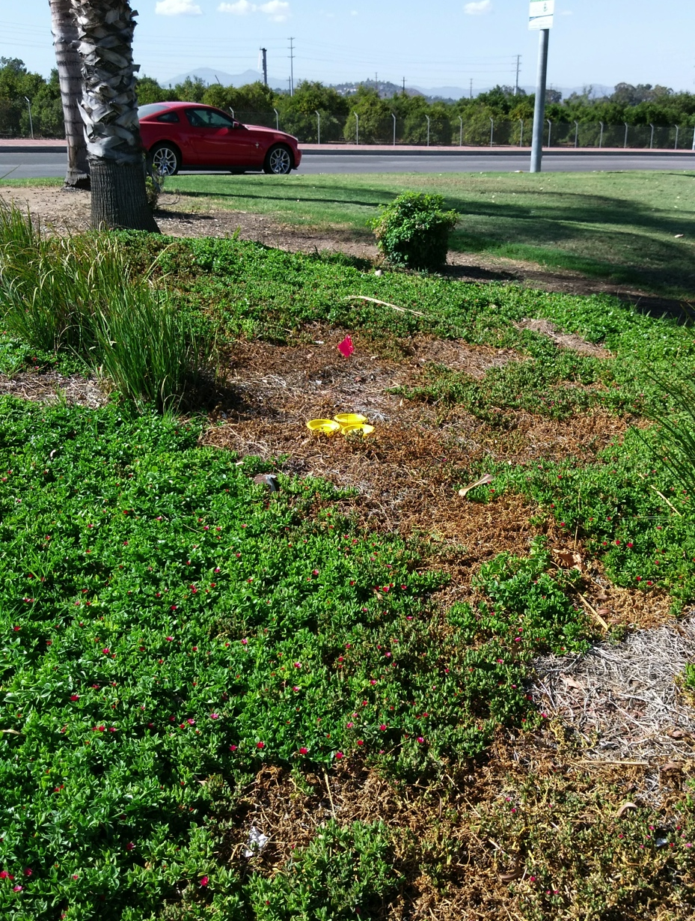
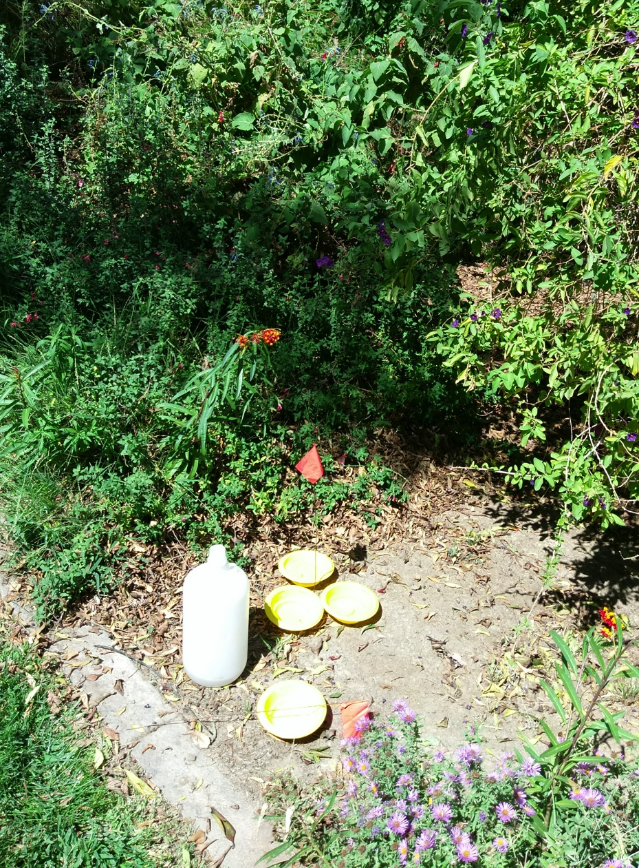
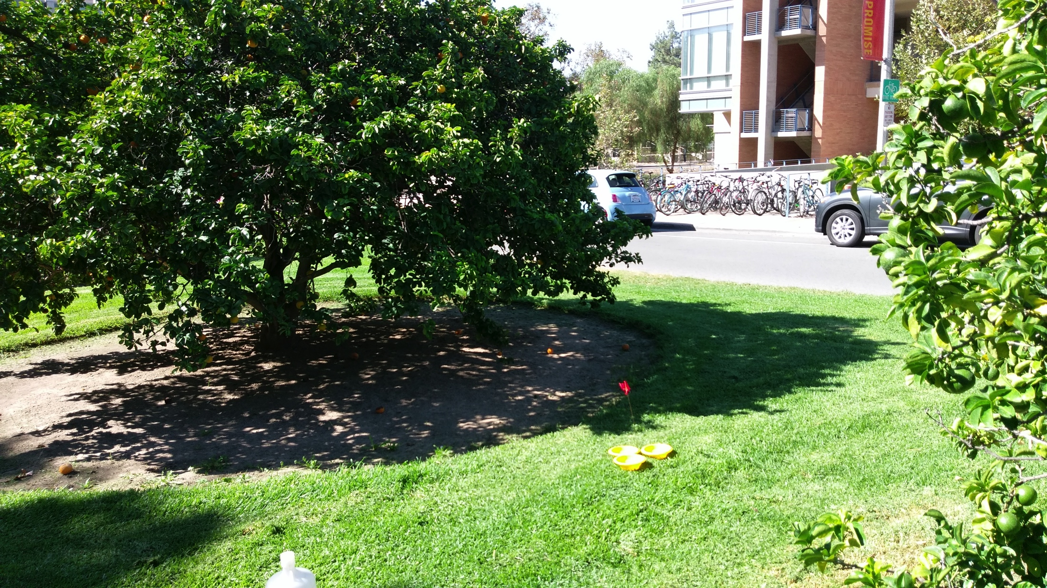
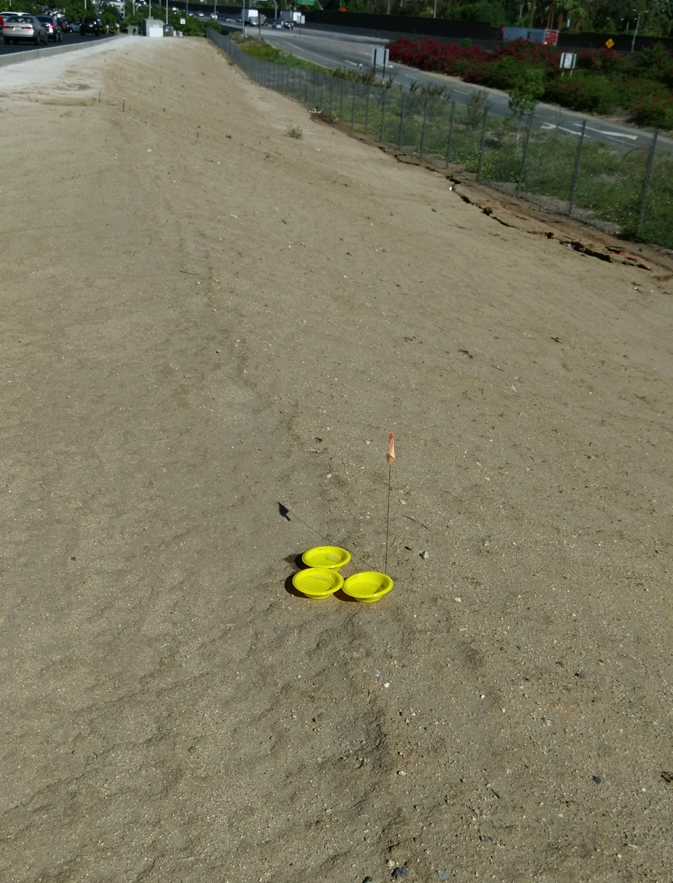
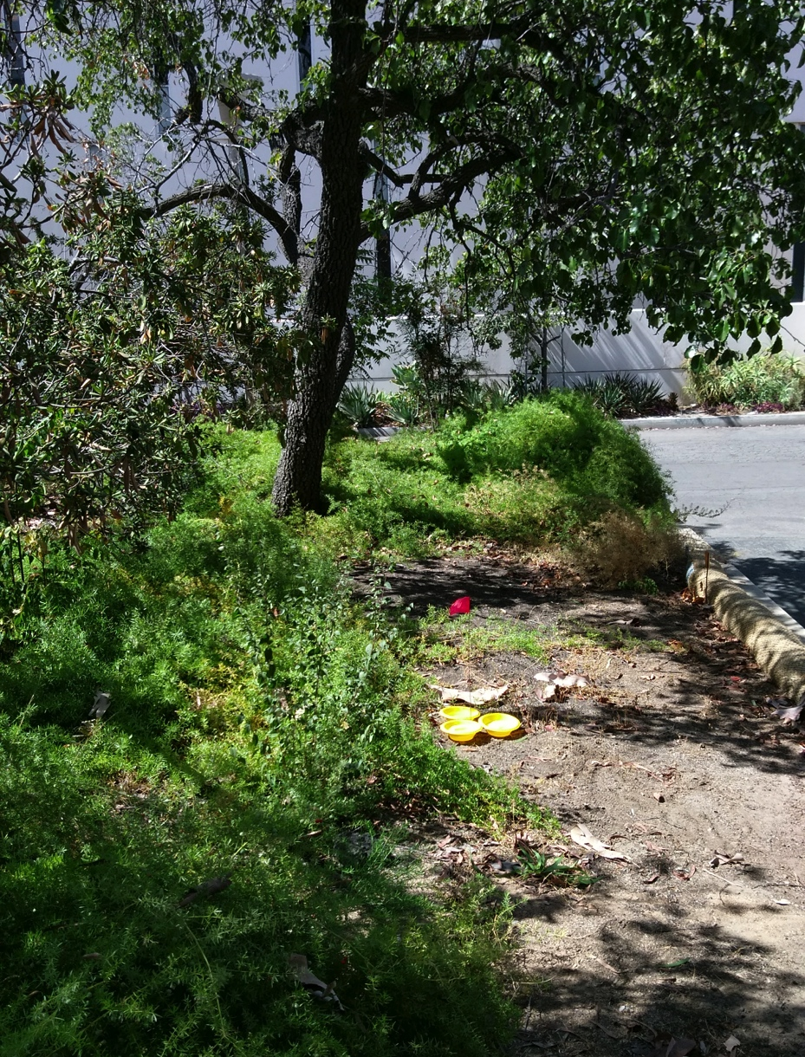
Pan trap set up
Place traps at pre-designated locations on campus
3 in the High Vegetation, 3 in the Low Vegetation
Fill trap with water to the fill line.
The solution will already have the soap added.

Slide 8
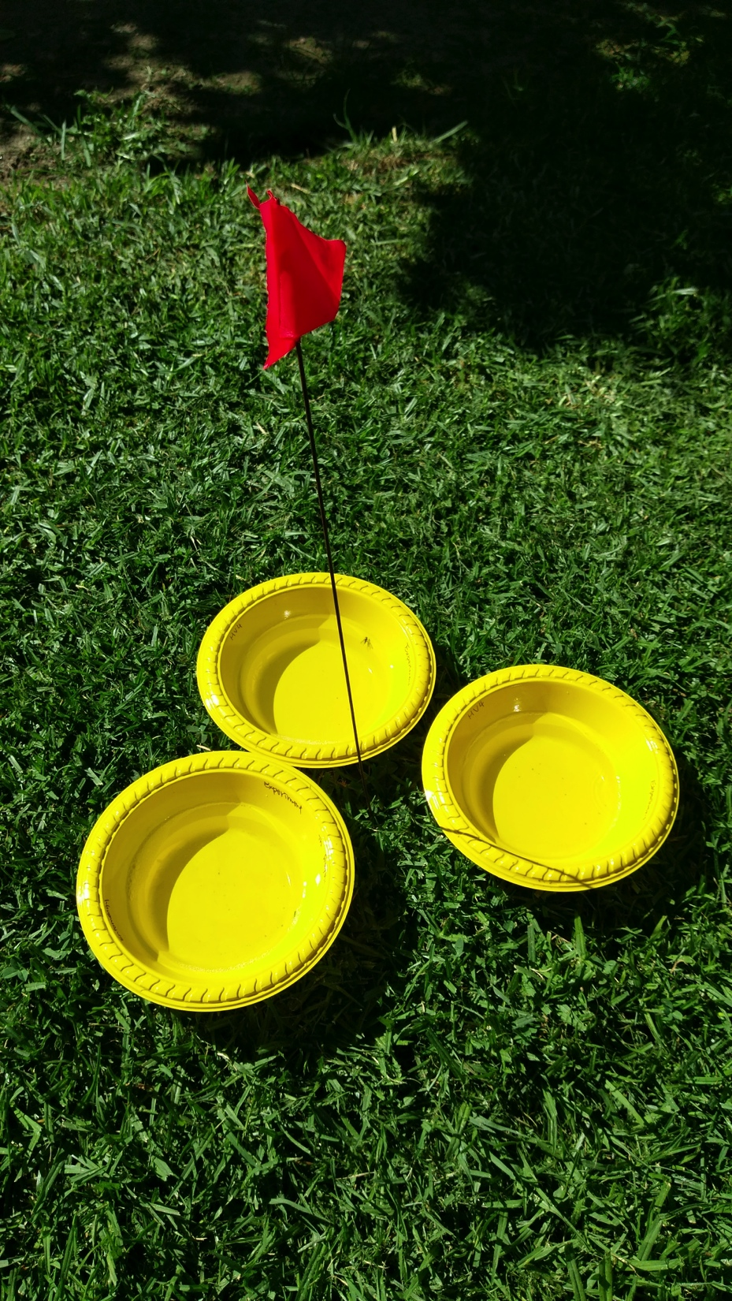
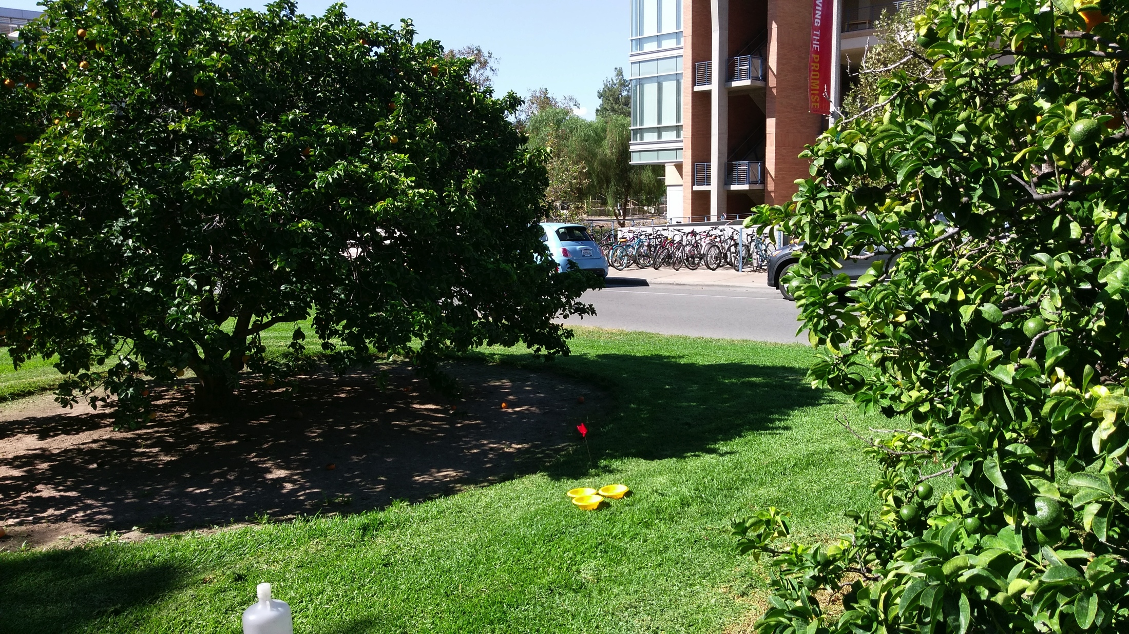
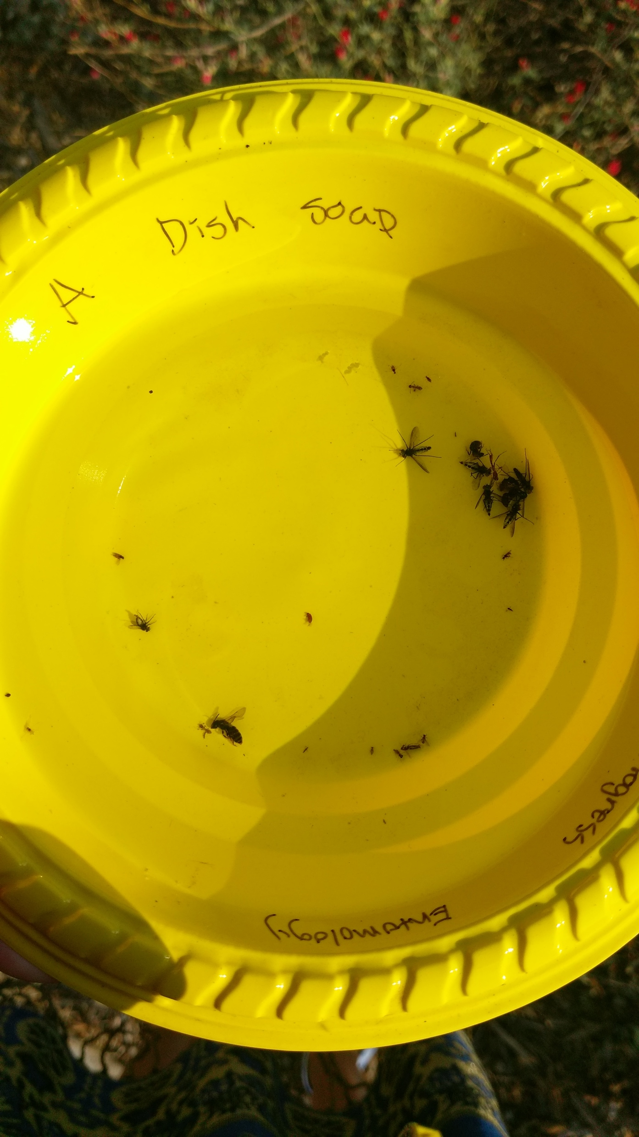
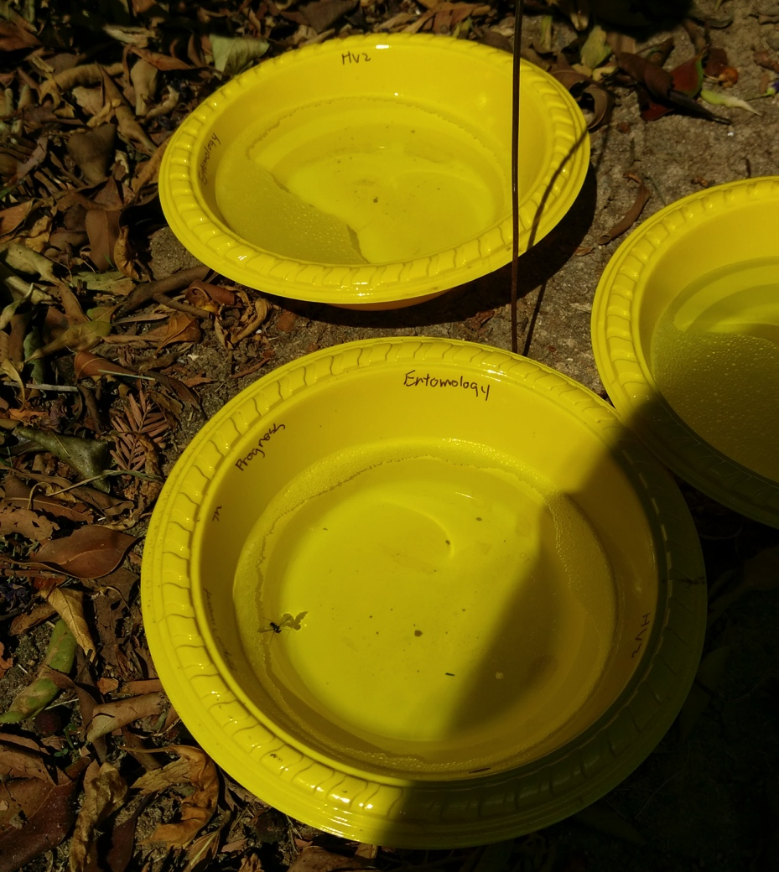
Pan trap set up
Place a marking flag next to each trap
Alerts people to not disturb the trap
Take photo of the trap after placement

Slide 9
Questions to think about
Which hymenopteran group do you think will be most numerous and which the least?
Will the placement of the trap, either high or low vegetation, influence the numbers?
Which group will be the most diverse, i.e. contain the most number of unique species?

Slide 10
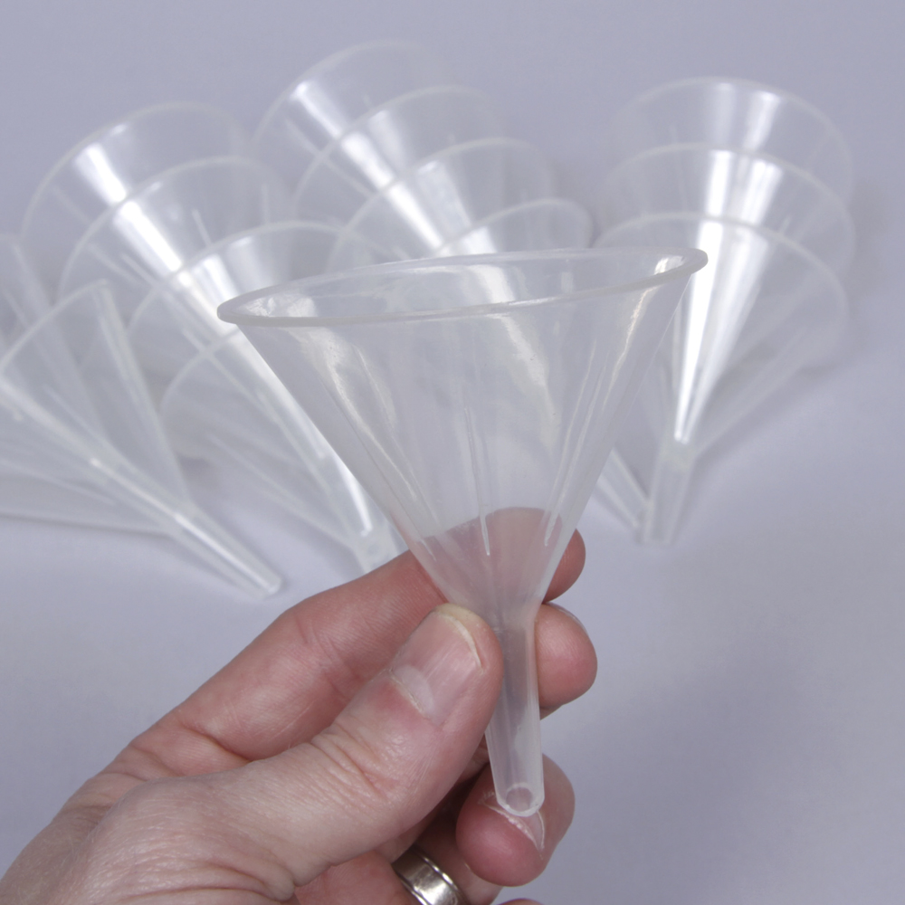
Pan trap recovery
Return 24 hours later to collect the contents of the traps
Take a photo of each trap before removing the contents
Give the trap a swirl first, to show any hidden insects
Transfer the contents of the traps into a labeled plastic bottle, using a funnel
Label each bottle with the appropriate trap number

Slide 11
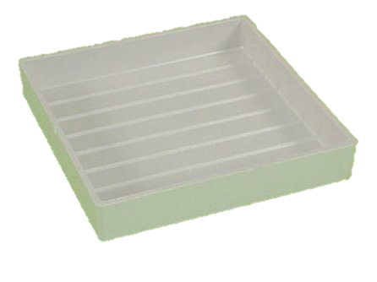
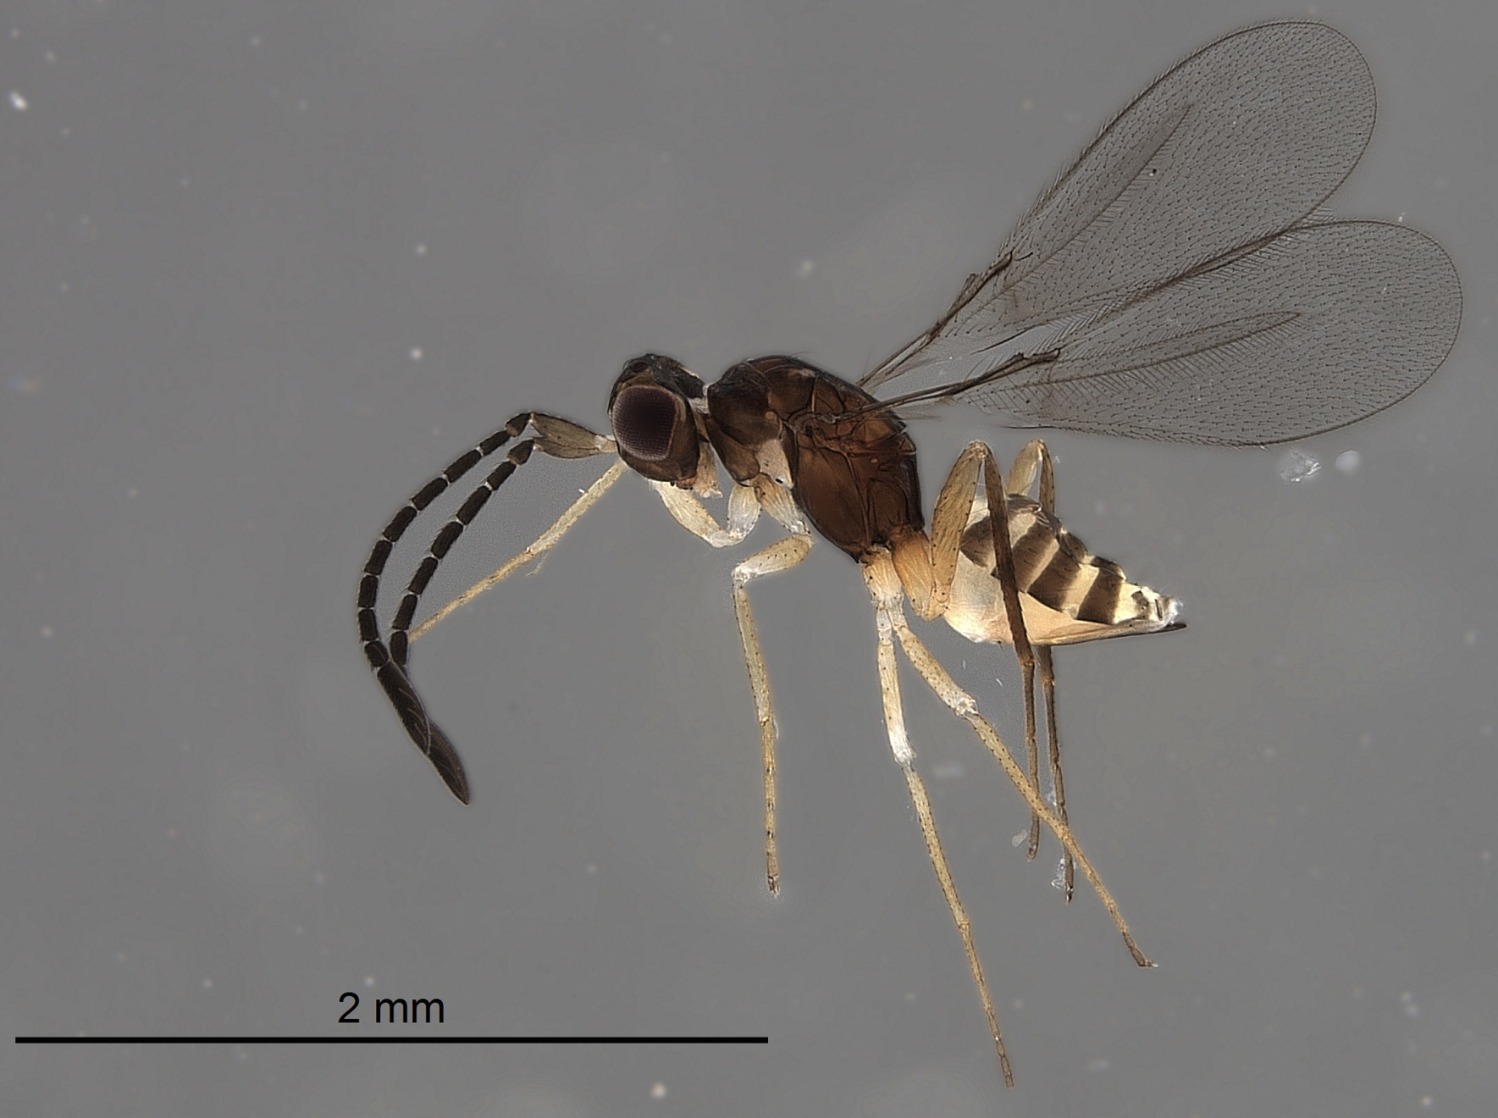
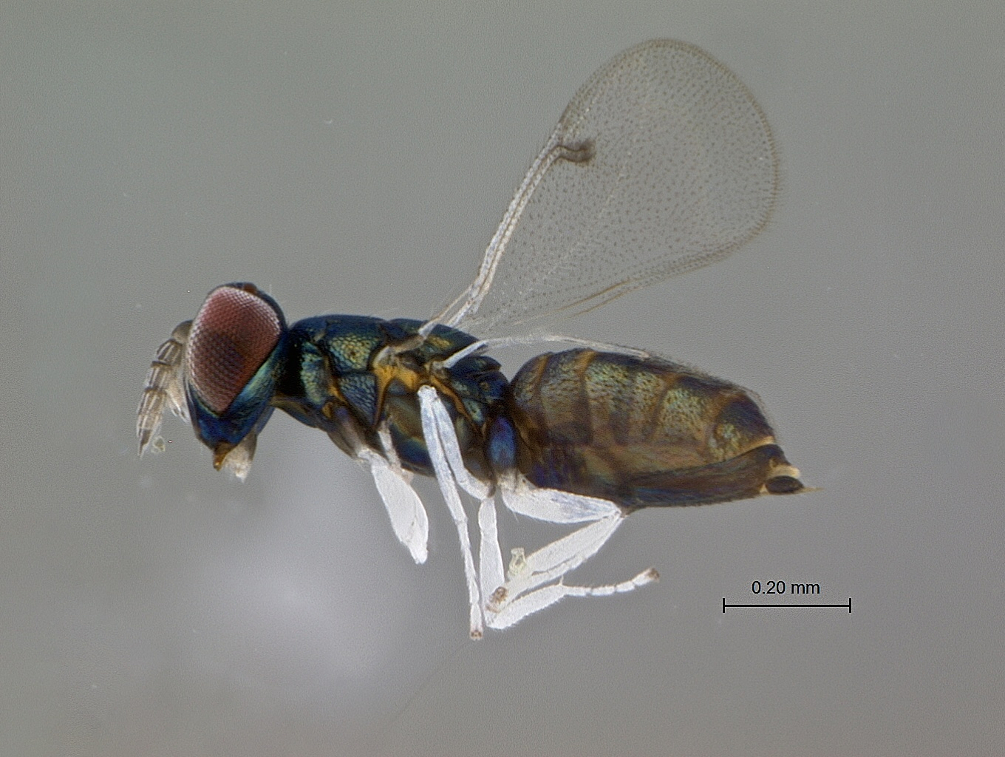
Classroom Sorting
Transfer contents from plastic tubes into sorting trays and place under microscope
Sort the specimens into groups
Pollinators, predators, parasitoids, and others
“Others” means all other insects, spiders, etc.
Use the provided keys, and website photos to identify the specimens
Record the numbers of each group, at each location, in each trap in the worksheet

Slide 12
Your Results
The results will be collected, and transferred into a master spreadsheet.
Notice any trends that you see in the data
Are there any surprise results, or outcomes that you did not expect?
What does this experiment tell you about hymenopteran diversity?

Slide 13
Example Results
Trap experiment located on UC Riverside campus
Parasitoids were the most numerous in total numbers, and in both high and low vegetation traps
Low vs High Vegetation
Discovery & Exploration:
A species not known to be in California was found on campus, in great numbers.
Total Numbers of Hymenoptera Groups

